Slide 1
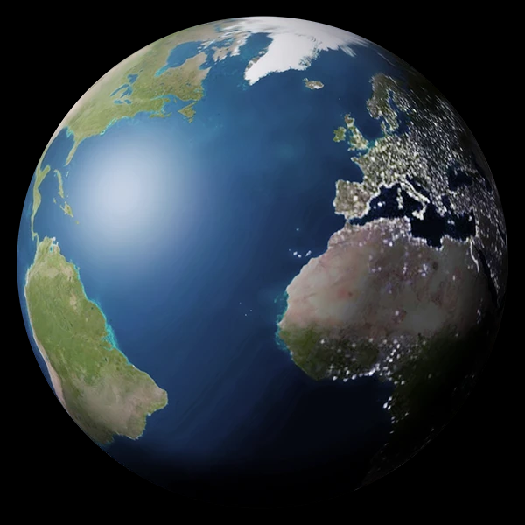
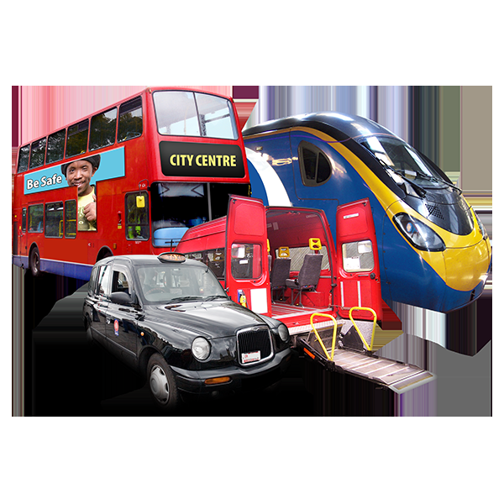
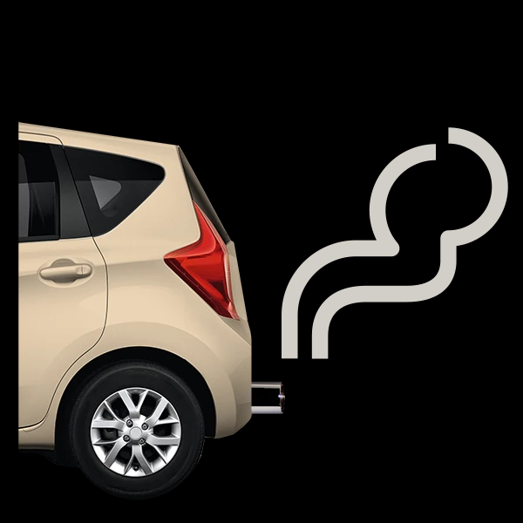
Transport East - Transport for a Greener World Competition - Easy Read
Transport East is a Partnership looking at making transport better for everyone where you live
A Partnership is where different
people and groups work together.
Transport is things like buses, trains, coaches, cars and taxis
Greener means living in a healthier world, like having better air to breathe. We are writing a strategy to help make this a healthier place to live in by the year 2050.

Slide 2
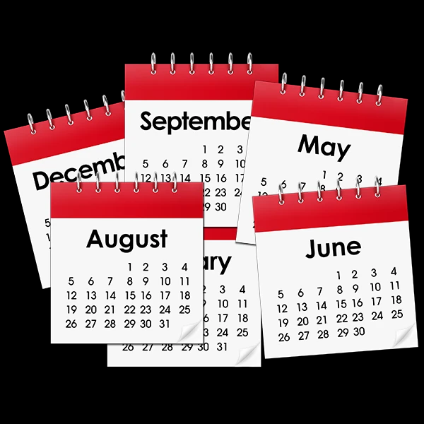
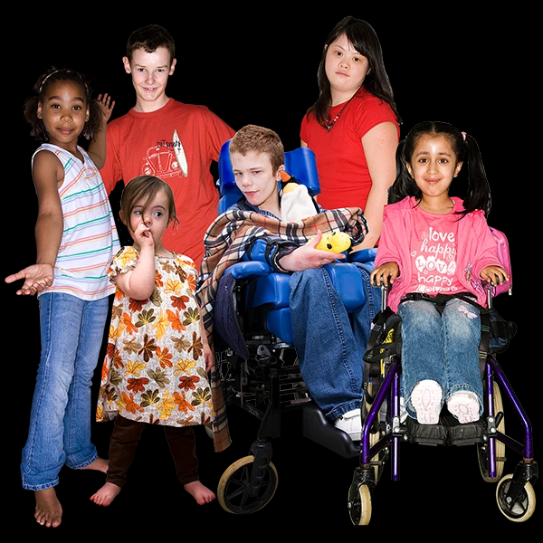
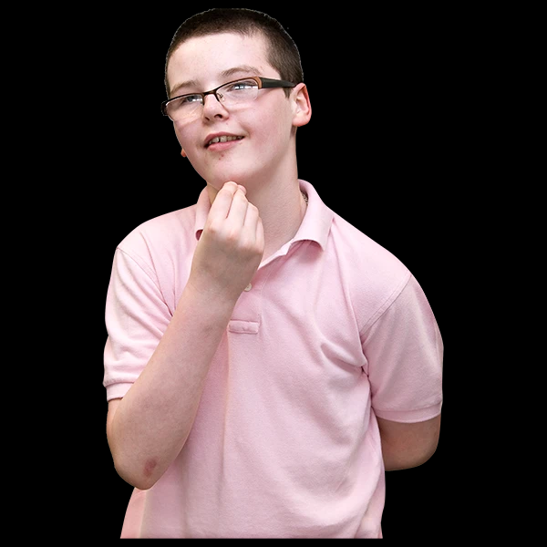
A strategy is a plan for how
something will be in the future
We want you to tell us how we can make things better.
If you are aged between 11 and 14, you can enter a competition
To enter, think of one type of transport and how travelling this way can be made better in the future, or how it can make the environment better
The environment is things like the air we breathe and the park where we meet and spend time

Slide 3
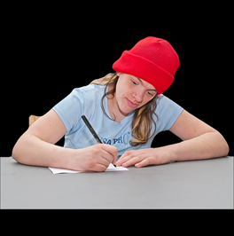
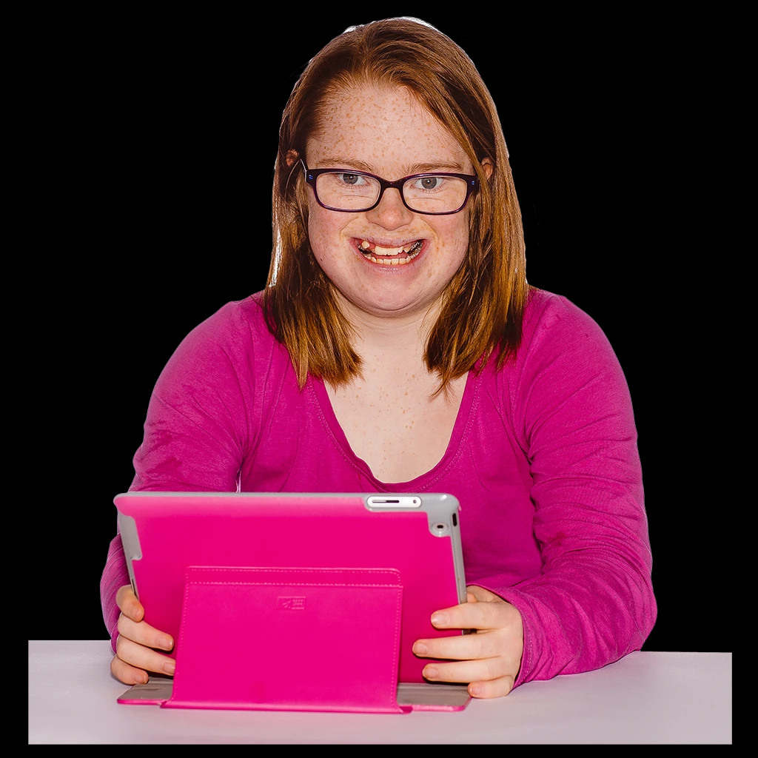
You can either make up a poem, story, song or rap in less than 500 words
Or you can make a drawing or painting. You can draw this by hand or use a computer to help you
You can only send your work to us once. You must not have used your work in other competitions
Email your entry to TransportEast@Suffolk.gov.uk. You must also tell us your name and the name of your school
Make sure you send your entry by 3rd May

Slide 4
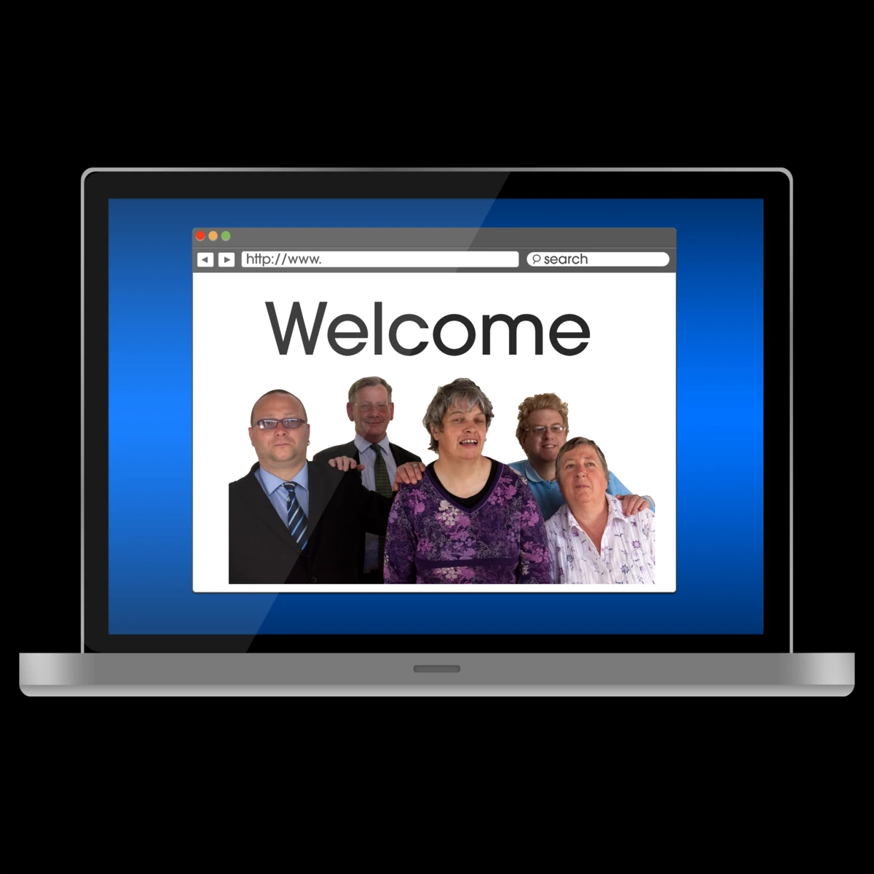
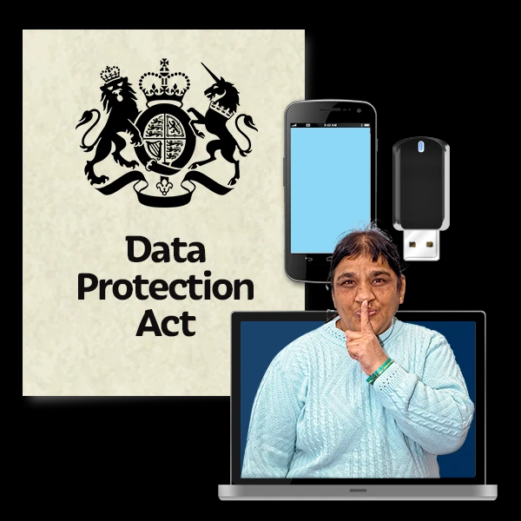
We will give the best 5 entries a £20 voucher for the Book shop, Waterstones
Transport East may also use your work on its website or in documents.
The personal information you give to us will be kept safe, correct and up to date, and we will only keep it for the ways for which you say we can use it.
If you or someone you know would like a copy of this document in another language or format, or you want more information please contact us at TransportEast@Suffolk.gov.uk
us at TransportEast@Suffolk.gov.uk
Pictures from Photosymbols. © Copyright Photosymbols Ltd

